Slide 1
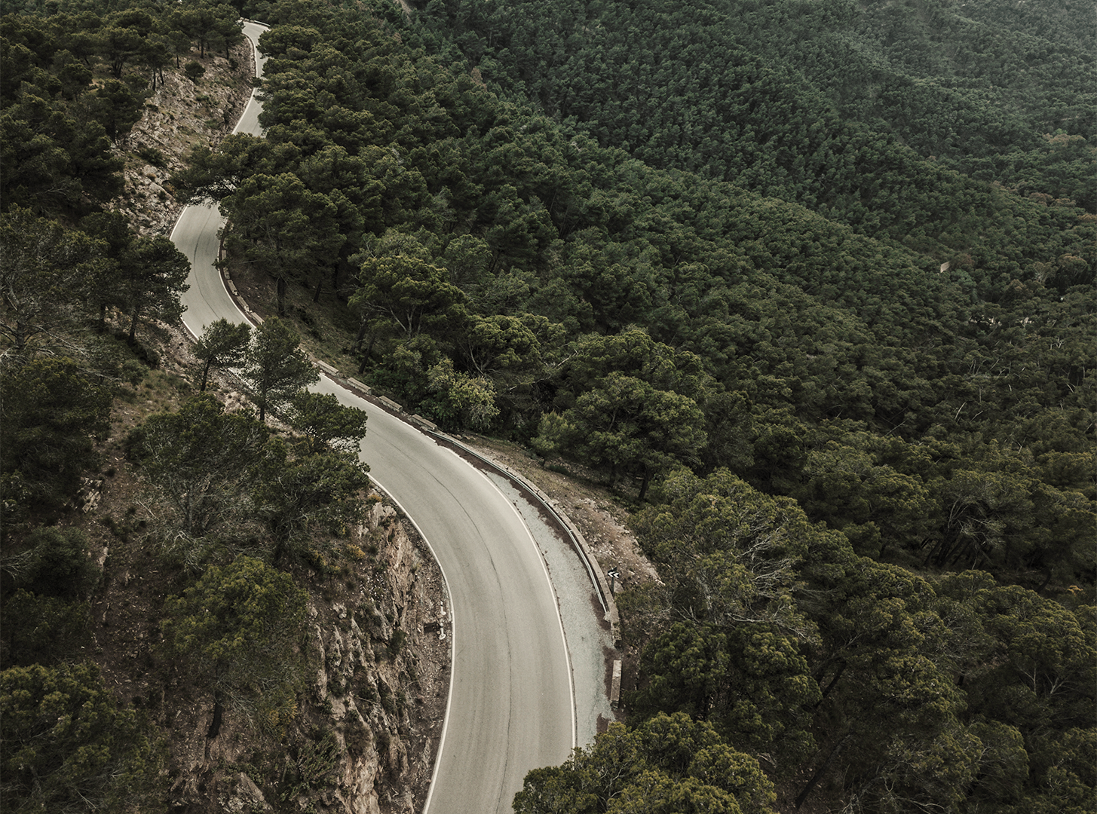
ENGINEERING
PROJECT
PROPOSAL
Here is where your presentation begins

Slide 2
CONTENTS OF THIS TEMPLATE
Here’s what you’ll find in this Slidesgo template:
A slide structure based on a Project Proposal, which you can easily adapt to your needs. For more info on how to edit the template, please visit Slidesgo School or read our FAQs.
An assortment of pictures to use in the presentation can be found in the alternative resources slide.
A credits slide, which you must keep so that proper credits for our design are given.
A resources slide, where you’ll find links to all the elements used in the template.
Instructions for use.
Final slides with:
The fonts and colors used in the template.
More infographic resources, whose size and color can be edited.
Sets of customizable icons of the following themes: general, business, avatar, creative process, education, help & support, medical, nature, performing arts, SEO & marketing, and teamwork.
You can delete this slide when you’re done editing the presentation.

Slide 3
ABOUT THE PROJECT
01
MAJOR REQUIREMENTS
02
TABLE OF CONTENTS
PROJECT GOALS
03
SNEAK PEEK
04
PROJECT STAGES
05
Here you could describe the topic of the section
Here you could describe the topic of the section
Here you could describe the topic of the section
Here you could describe the topic of the section
Here you could describe the topic of the section

Slide 4
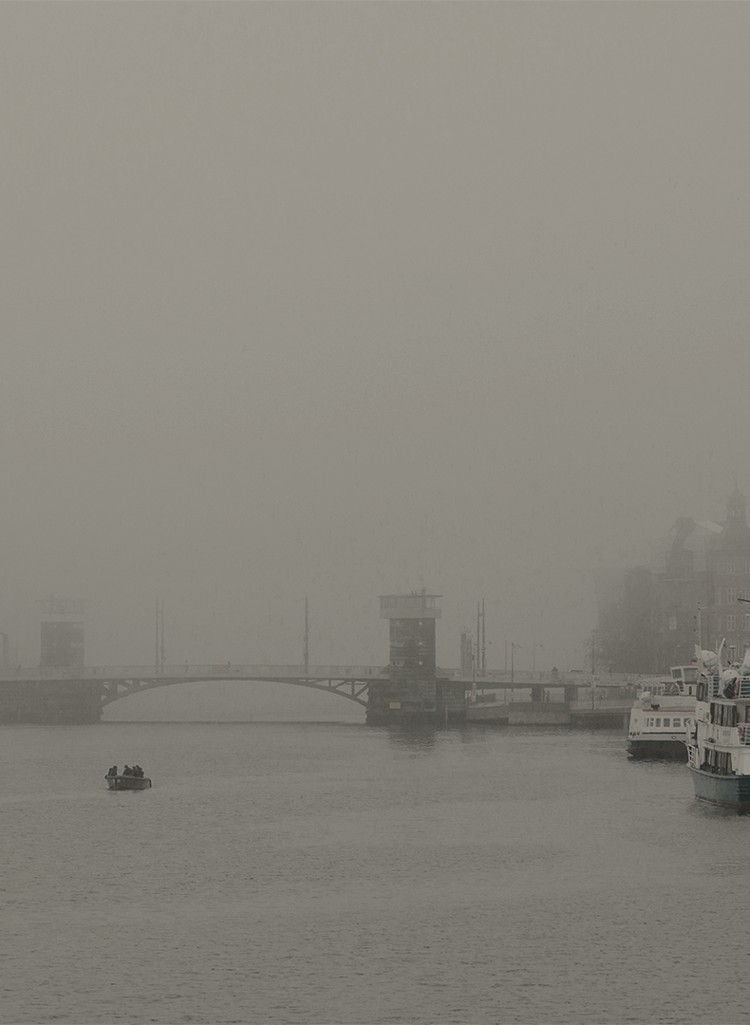

OUR COMPANY
Mercury is the closest planet to the Sun and the smallest one in the Solar System—it’s only a bit larger than our Moon. The planet’s name has nothing to do with the liquid metal since it was named after the Roman messenger god, Mercury

Slide 5
ROAD BRIDGES
INDUSTRIAL BUILDINGS
WHAT WE ARE WORKING ON
SUBWAY STATIONS
THERMAL POWER STATIONS
Despite being red, Mars is a cold place, not hot. It’s full of iron oxide dust, which gives the planet its reddish cast
Jupiter is a gas giant and the biggest planet in our Solar System. It’s the fourth-brightest object in the sky
Yes, Saturn is the ringed one. This planet is a gas giant, and it’s composed mostly of hydrogen and helium
Venus has a beautiful name and is the second planet from the Sun. It’s terribly hot, even hotter than Mercury

Slide 6
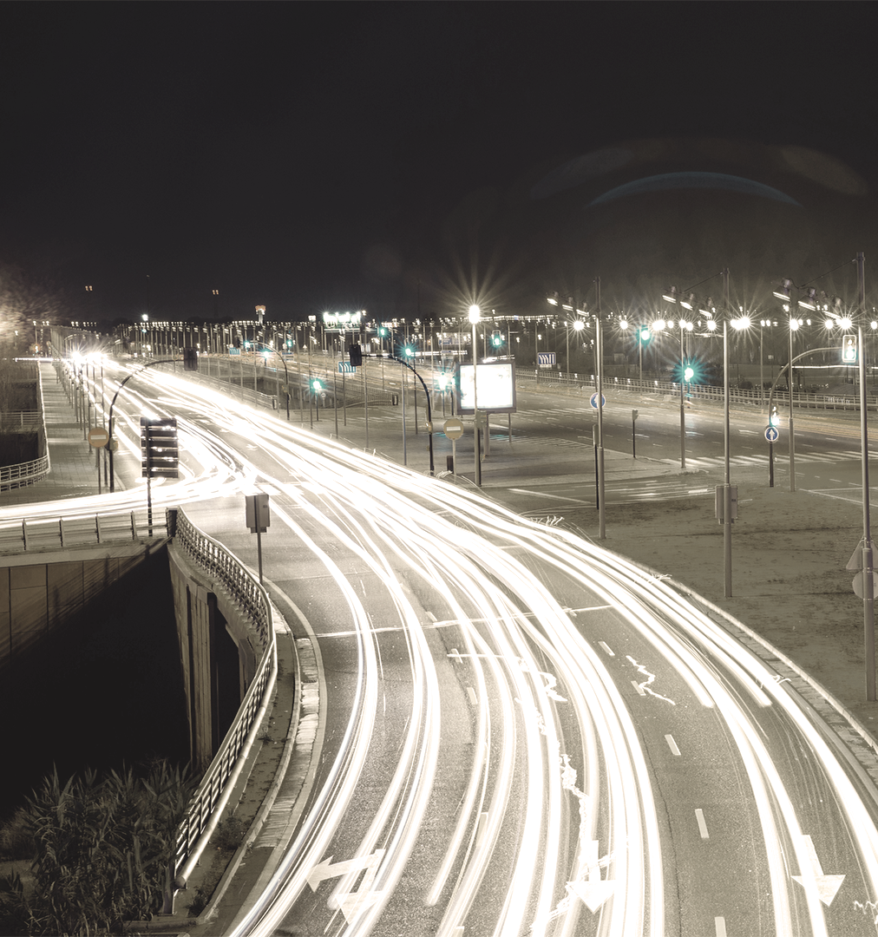
ABOUT THE PROJECT
Mercury is the closest planet to the Sun and the smallest one in the Solar System—it’s only a bit larger than our Moon. The planet’s name has nothing to do with the liquid metal since it was named after the Roman messenger god, Mercury

Slide 7
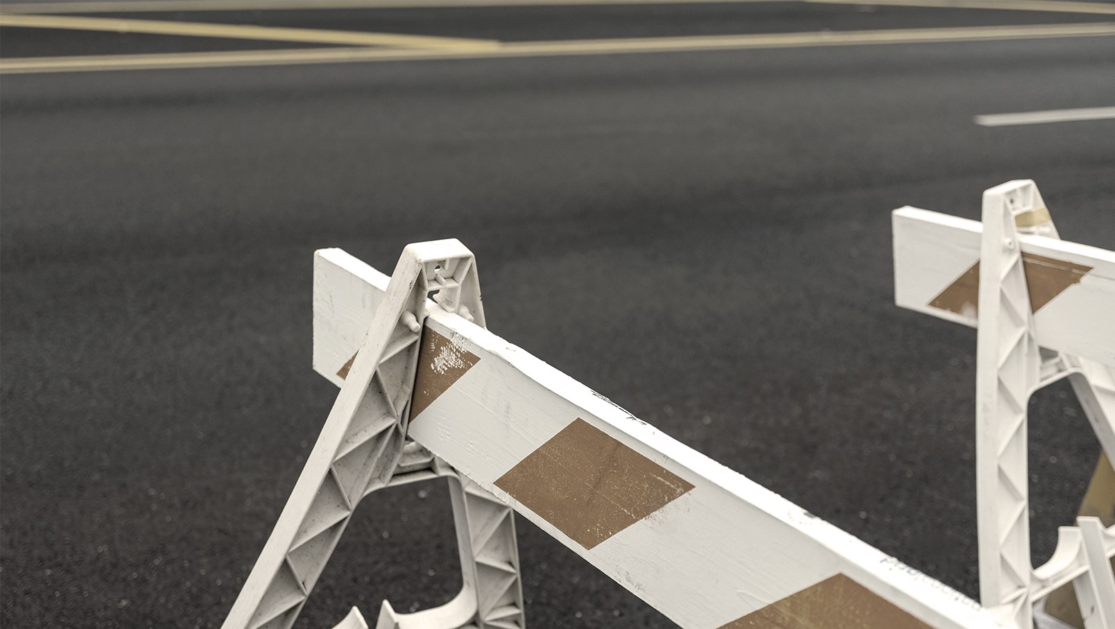
NOW
Mercury is the closest planet to the Sun and the smallest one in our Solar System—it’s only a bit larger than our Moon. The planet’s name has nothing to do with the liquid metal, since it was named after the Roman messenger god

